Slide 1
Math 263 Section 7
Discrete Mathematics
Tuesdays and Thursdays
12:30-1:45pm
YR-129

Slide 2
Math 263 Section 8
Discrete Mathematics
Tuesdays and Thursdays
2:00-3:15pm
YR-129

Slide 3
Math 263: Discrete Mathematics
Agenda/Announcements/Reminders:
Recordings of the class sessions and office hours will be available (with delay) on Zoom under “Cloud Recordings”.
Webassign & PHW for 2.1 due on Monday 9/4 at 11:59pm
Quiz 0 on Thursday 8/31 in class covering Syllabus.
Please include your course and section # in all future emails.
While using Lecture Slides, download a fresh copy each time.
You can get extra credit if you see me during office hours in the first week and discuss a problem.

Slide 4
Math 263: Discrete Mathematics
Agenda/Announcements/Reminders:
Dr. Walia Office Hours (on Zoom)
and by appointment.
On T,Th, I’ll also be available in-person in my office YR-353 and might be a few minutes late. On Fridays, I might be able to hold office hours from 3:30-4:30pm if requested ahead of time.
Please go to blackboard, click on “Zoom Meetings”, and then join the Zoom session “Office Hours” for the day. Recordings will be available soon after.
Online Tutoring Center link
Monday | Tuesday | Wednesday | Thursday
2:00-3:00pm | 3:30-4:30pm | 2:00-3:00pm | 3:30-4:30pm

Slide 5
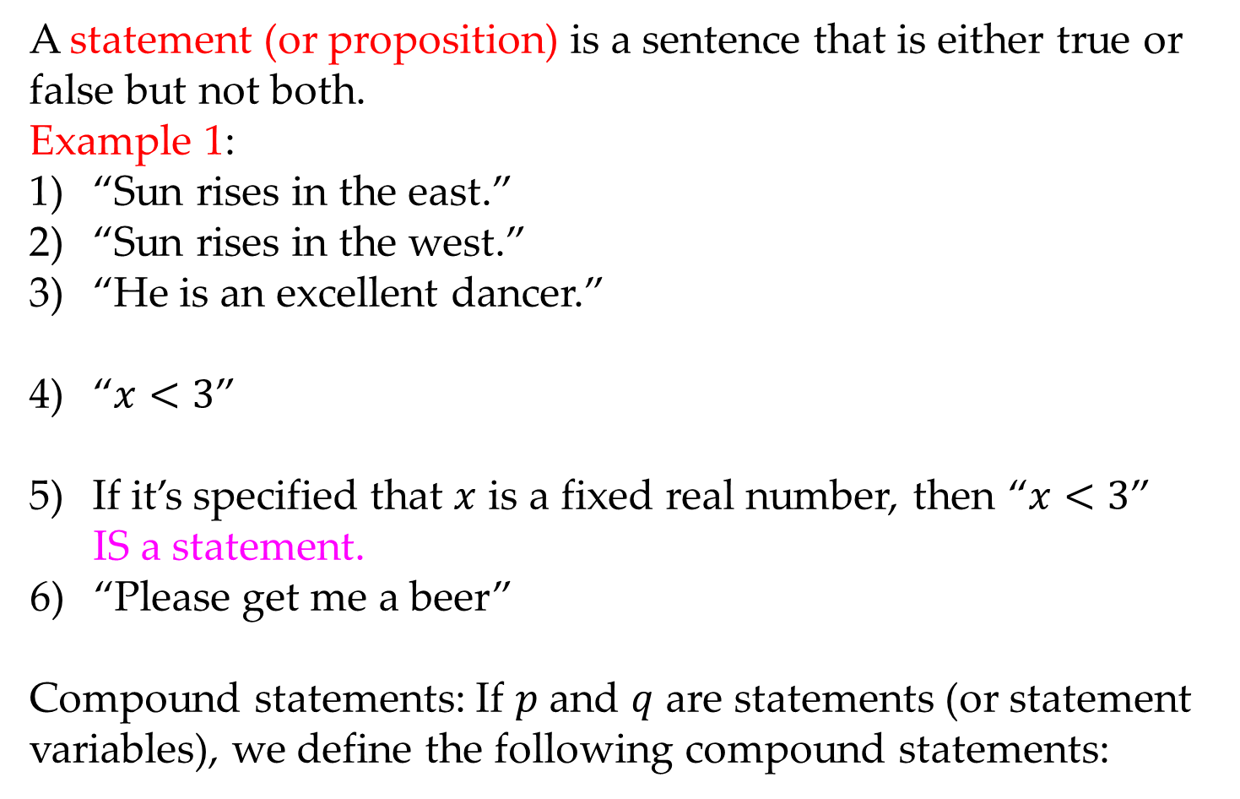
Math 263: Discrete Mathematics
2.1: Definitions
A statement (or proposition) is a sentence that is either true or false but not both.
Example 1:
“Sun rises in the east.”
“Sun rises in the west.”
“He is an excellent dancer.”
“$x<3$”
If it’s specified that $x$ is a fixed real number, then “$x<3$”
IS a statement.
“Please get me a beer”
Compound statements: If $p$ and $q$ are statements (or statement variables), we define the following compound statements:
is not a statement, because the it’s truth or falsity depends on the reference “He”.
is not a statement, because it’s not clear what $x$ is.
is not a statement.

Slide 6
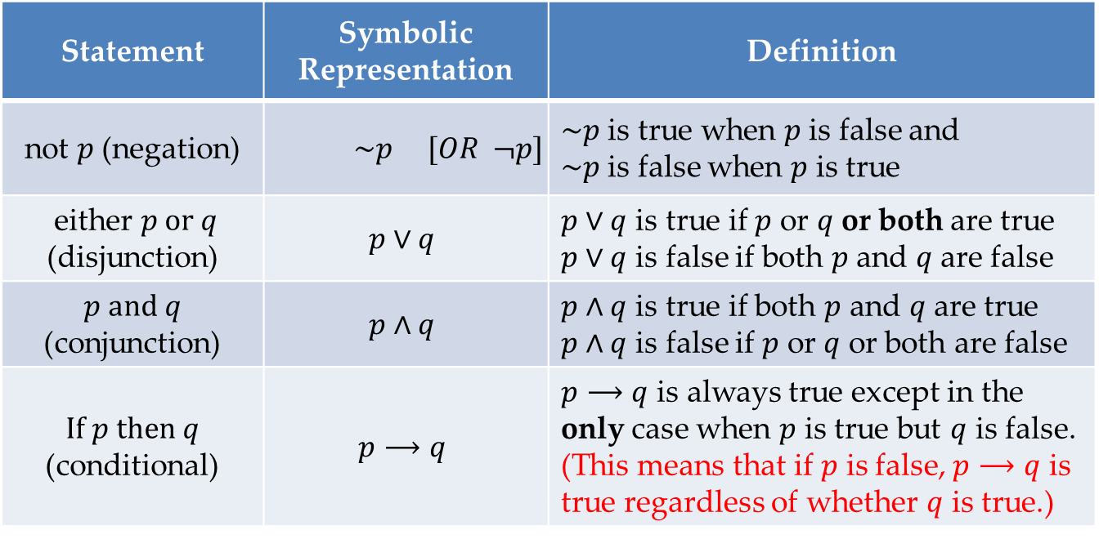

Math 263: Discrete Mathematics
2.1: Definitions
Compound Statements: If $p$ and $q$ are statements (or statement variables), we define the following compound statements:
Order of statements: First evaluate parenthesis $\left( \right),$then negations $\sim ,$then $∨\&∧$, and then $⟶$.
Statement | Symbolic Representation | Definition
not $p$ (negation) | $$\sim p [OR ¬p]$$ | $\sim p$ is true when $p$ is false and $\sim p$ is false when $p$ is true
either $p or q$ (disjunction) | $$p∨q$$ | $p∨q$ is true if $p$ or $q$ or both are true $p∨q$ is false if both $p$ and $q$ are false
$p and q$ (conjunction) | $$p∧q$$ | $p∧q$ is true if both $p$ and $q$ are true $p∧q$ is false if $p$ or $q$ or both are false
$If p then q$ (conditional) | $$p⟶q$$ | $p⟶q$ is always true except in the only case when $p$ is true but $q$ is false. (This means that if $p$ is false, $p⟶q$ is true regardless of whether $q$ is true.)

Slide 7
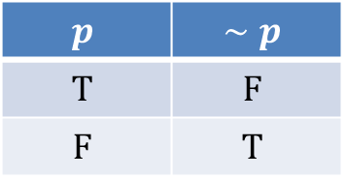
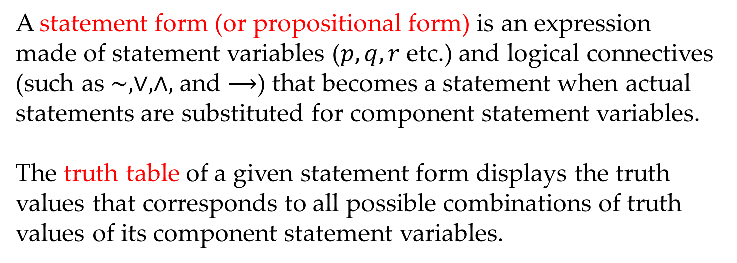
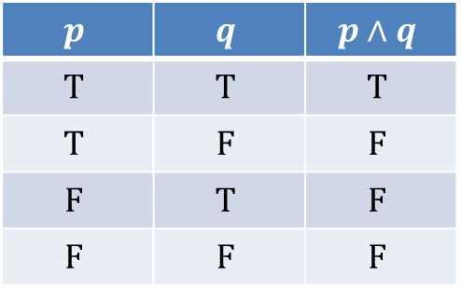

Math 263: Discrete Mathematics
2.1: Statement Forms & Truth Tables
A statement form (or propositional form) is an expression made of statement variables ($p,q, r$ etc.) and logical connectives (such as $\sim , ∨, ∧,$ and $⟶$) that becomes a statement when actual statements are substituted for component statement variables.
The truth table of a given statement form displays the truth values that corresponds to all possible combinations of truth values of its component statement variables.
$$p$$ | $$∼p$$
$$T$$ | $$F$$
$$F$$ | $$T$$
$$p$$ | $$q$$ | $$p∨q$$
$$T$$ | $$T$$ | $$T$$
$$T$$ | $$F$$ | $$T$$
$$F$$ | $$T$$ | $$T$$
$$F$$ | $$F$$ | $$F$$
$$p$$ | $$q$$ | $$p∧q$$
$$T$$ | $$T$$ | $$T$$
$$T$$ | $$F$$ | $$F$$
$$F$$ | $$T$$ | $$F$$
$$F$$ | $$F$$ | $$F$$

Slide 8
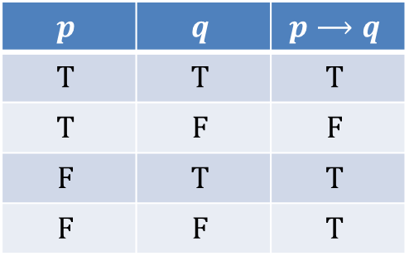
Math 263: Discrete Mathematics
2.1: Statement Forms & Truth Tables
A statement form (or propositional form) is an expression made of statement variables ($p,q, r$ etc.) and logical connectives (such as $\sim , ∨, ∧,$ and $⟶$) that becomes a statement when actual statements are substituted for component statement variables.
The truth table of a given statement form displays the truth values that corresponds to all possible combinations of truth values of its component statement variables.
$$p$$ | $$q$$ | $$p⟶q$$
$$T$$ | $$T$$ | $$T$$
$$T$$ | $$F$$ | $$F$$
$$F$$ | $$T$$ | $$T$$
$$F$$ | $$F$$ | $$T$$

Slide 9
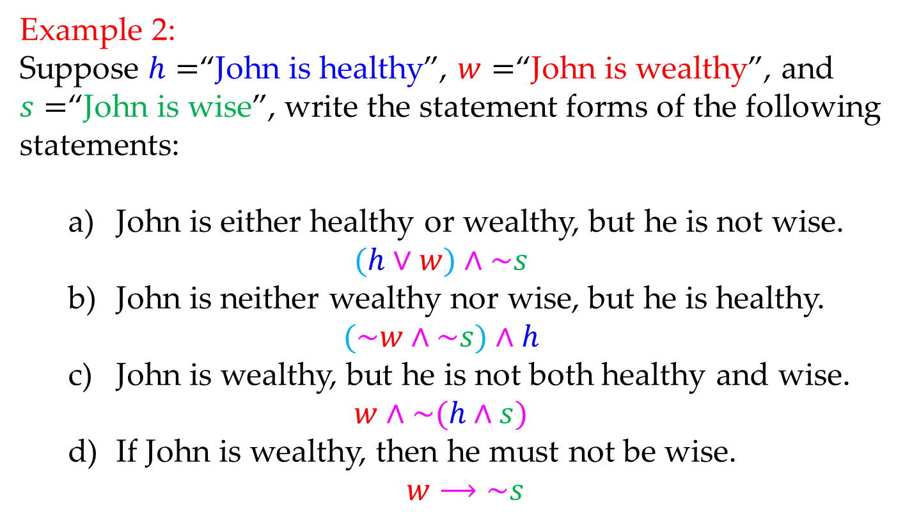
Math 263: Discrete Mathematics
2.1: Example
Example 2:
Suppose $h=$“John is healthy”, $w=$“John is wealthy”, and $s=$“John is wise”, write the statement forms of the following statements:
John is either healthy or wealthy, but he is not wise.
$$(h∨w)∧\sim s$$
John is neither wealthy nor wise, but he is healthy.
$$(\sim w∧\sim s)∧h$$
John is wealthy, but he is not both healthy and wise.
$$w∧\sim (h∧s)$$
If John is wealthy, then he must not be wise.
$$w⟶\sim s$$

Slide 10
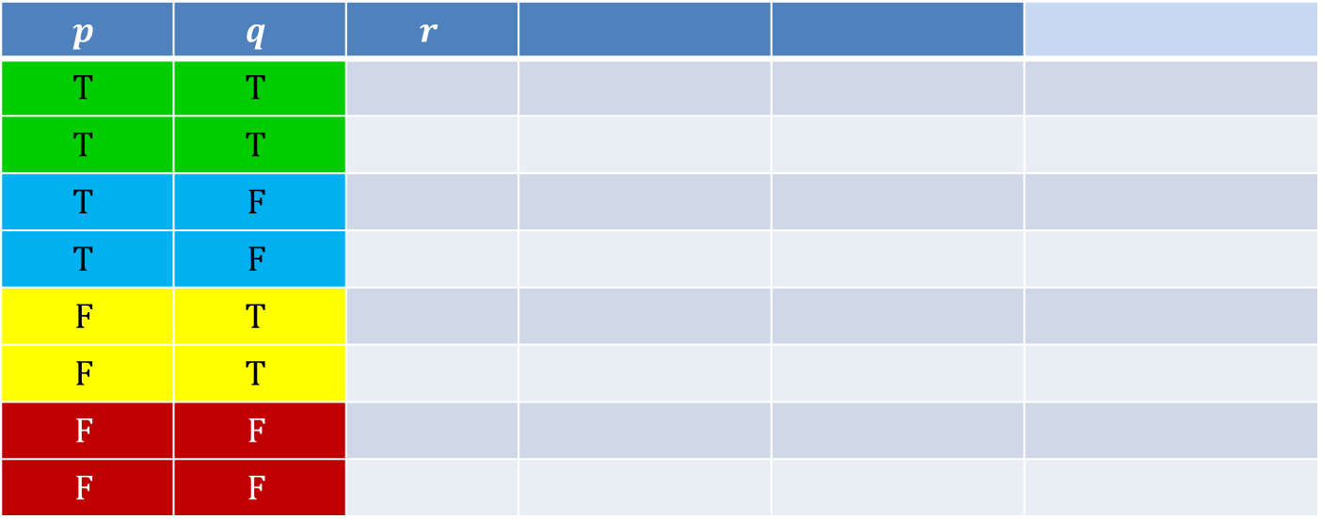
Math 263: Discrete Mathematics
2.1: Truth Tables
The truth table for $p⟶\sim (q∨r)$
$$p$$ | $$q$$ | $$r$$
$$T$$ | $$T$$
$$T$$ | $$T$$
$$T$$ | $$F$$
$$T$$ | $$F$$
$$F$$ | $$T$$
$$F$$ | $$T$$
$$F$$ | $$F$$
$$F$$ | $$F$$

Slide 11
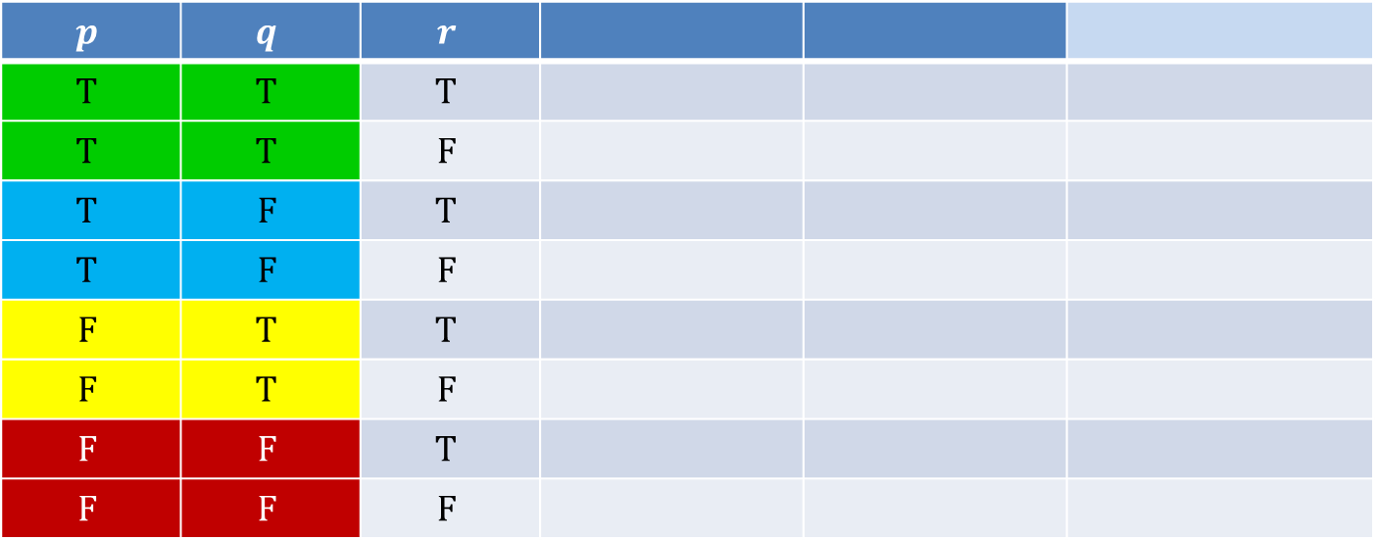
Math 263: Discrete Mathematics
2.1: Truth Tables
The truth table for $p⟶\sim (q∨r)$
$$p$$ | $$q$$ | $$r$$
$$T$$ | $$T$$ | $$T$$
$$T$$ | $$T$$ | $$F$$
$$T$$ | $$F$$ | $$T$$
$$T$$ | $$F$$ | $$F$$
$$F$$ | $$T$$ | $$T$$
$$F$$ | $$T$$ | $$F$$
$$F$$ | $$F$$ | $$T$$
$$F$$ | $$F$$ | $$F$$

Slide 12
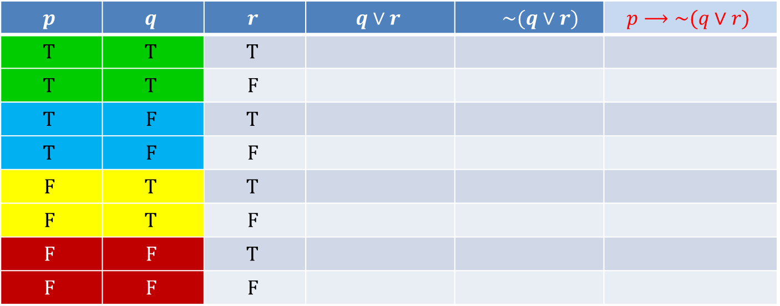
Math 263: Discrete Mathematics
2.1: Truth Tables
The truth table for $p⟶\sim (q∨r)$
$$p$$ | $$q$$ | $$r$$ | $$q∨r$$ | $$\sim (q∨r)$$ | $$p⟶\sim (q∨r)$$
$$T$$ | $$T$$ | $$T$$
$$T$$ | $$T$$ | $$F$$
$$T$$ | $$F$$ | $$T$$
$$T$$ | $$F$$ | $$F$$
$$F$$ | $$T$$ | $$T$$
$$F$$ | $$T$$ | $$F$$
$$F$$ | $$F$$ | $$T$$
$$F$$ | $$F$$ | $$F$$

Slide 13

Math 263: Discrete Mathematics
2.1: Truth Tables
The truth table for $p⟶\sim (q∨r)$
$$p$$ | $$q$$ | $$r$$ | $$q∨r$$ | $$\sim (q∨r)$$ | $$p⟶\sim (q∨r)$$
$$T$$ | $$T$$ | $$T$$ | $$T$$
$$T$$ | $$T$$ | $$F$$ | $$T$$
$$T$$ | $$F$$ | $$T$$ | $$T$$
$$T$$ | $$F$$ | $$F$$ | $$F$$
$$F$$ | $$T$$ | $$T$$ | $$T$$
$$F$$ | $$T$$ | $$F$$ | $$T$$
$$F$$ | $$F$$ | $$T$$ | $$T$$
$$F$$ | $$F$$ | $$F$$ | $$F$$

Slide 14

Math 263: Discrete Mathematics
2.1: Truth Tables
The truth table for $p⟶\sim (q∨r)$
$$p$$ | $$q$$ | $$r$$ | $$q∨r$$ | $$\sim (q∨r)$$ | $$p⟶\sim (q∨r)$$
$$T$$ | $$T$$ | $$T$$ | $$T$$ | $$F$$
$$T$$ | $$T$$ | $$F$$ | $$T$$ | $$F$$
$$T$$ | $$F$$ | $$T$$ | $$T$$ | $$F$$
$$T$$ | $$F$$ | $$F$$ | $$F$$ | $$T$$
$$F$$ | $$T$$ | $$T$$ | $$T$$ | $$F$$
$$F$$ | $$T$$ | $$F$$ | $$T$$ | $$F$$
$$F$$ | $$F$$ | $$T$$ | $$T$$ | $$F$$
$$F$$ | $$F$$ | $$F$$ | $$F$$ | $$T$$

Slide 15

Math 263: Discrete Mathematics
2.1: Truth Tables
The truth table for $p⟶\sim (q∨r)$
$$p$$ | $$q$$ | $$r$$ | $$q∨r$$ | $$\sim (q∨r)$$ | $$p⟶\sim (q∨r)$$
$$T$$ | $$T$$ | $$T$$ | $$T$$ | $$F$$ | $$F$$
$$T$$ | $$T$$ | $$F$$ | $$T$$ | $$F$$ | $$F$$
$$T$$ | $$F$$ | $$T$$ | $$T$$ | $$F$$ | $$F$$
$$T$$ | $$F$$ | $$F$$ | $$F$$ | $$T$$ | $$T$$
$$F$$ | $$T$$ | $$T$$ | $$T$$ | $$F$$ | $$T$$
$$F$$ | $$T$$ | $$F$$ | $$T$$ | $$F$$ | $$T$$
$$F$$ | $$F$$ | $$T$$ | $$T$$ | $$F$$ | $$T$$
$$F$$ | $$F$$ | $$F$$ | $$F$$ | $$T$$ | $$T$$

Slide 16
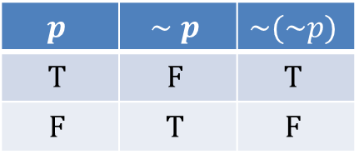
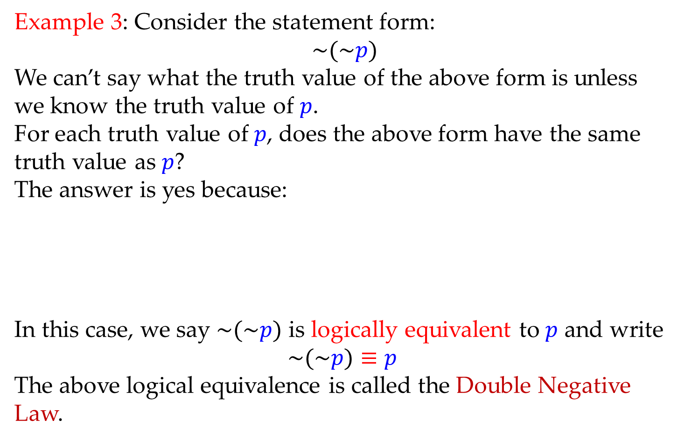
Math 263: Discrete Mathematics
2.1: Logical Equivalence
Example 3: Consider the statement form:
$\sim (\sim p)$
We can’t say what the truth value of the above form is unless we know the truth value of $p$.
For each truth value of $p$, does the above form have the same truth value as $p$?
The answer is yes because:
In this case, we say $\sim (\sim p)$ is logically equivalent to $p$ and write
$$\sim (\sim p)≡p$$
The above logical equivalence is called the Double Negative Law.
$$p$$ | $$∼p$$ | $$\sim (\sim p)$$
$$T$$ | $$F$$ | $$T$$
$$F$$ | $$T$$ | $$F$$

Slide 17
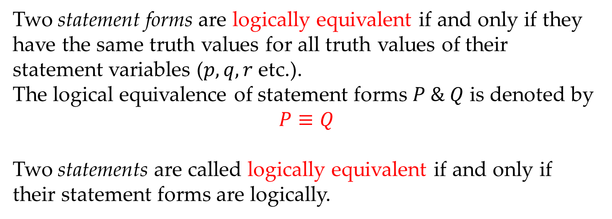
Math 263: Discrete Mathematics
2.1: Logical Equivalence
Two statement forms are logically equivalent if and only if they have the same truth values for all truth values of their statement variables ($p, q, r$ etc.).
The logical equivalence of statement forms $P \& Q$ is denoted by
$$P≡Q$$
Two statements are called logically equivalent if and only if their statement forms are logically.

Slide 18
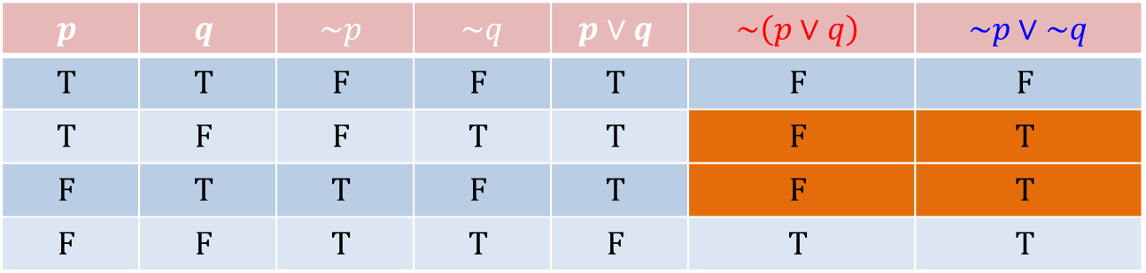
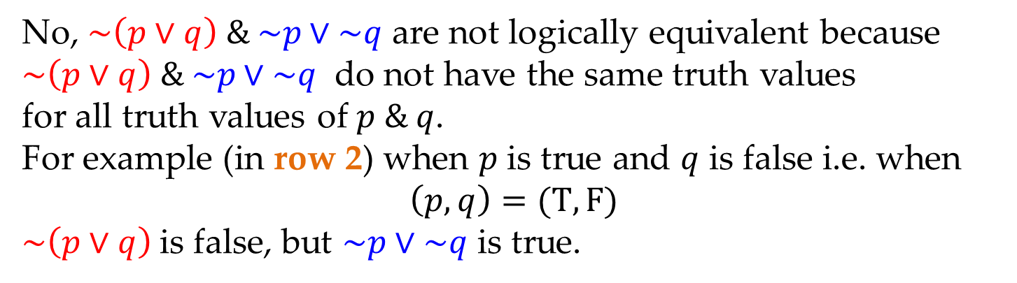
Math 263: Discrete Mathematics
2.1: Logical Equivalence
Example 4: Is it true that $\sim \left(p∨q\right)≡\sim p∨\sim q$ ? Why?
$$p$$ | $$q$$ | $$\sim p$$ | $\sim q$ | $$p∨q$$ | $$\sim \left(p∨q\right)$$ | $\sim p∨\sim q$
$$T$$ | $$T$$ | $$F$$ | $$F$$ | $$T$$ | $$F$$ | $$F$$
$$T$$ | $$F$$ | $$F$$ | $$T$$ | $$T$$ | $$F$$ | $$T$$
$$F$$ | $$T$$ | $$T$$ | $$F$$ | $$T$$ | $$F$$ | $$T$$
$$F$$ | $$F$$ | $$T$$ | $$T$$ | $$F$$ | $$T$$ | $$T$$
No, $\sim \left(p∨q\right) \& \sim p∨\sim q$ are not logically equivalent because
$\sim \left(p∨q\right) \& \sim p∨\sim q$ do not have the same truth values
for all truth values of $p \& q$.
For example (in row 2) when $p$ is true and $q$ is false i.e. when
$\left(p,q\right)=(T,F)$
$\sim \left(p∨q\right)$is false, but $\sim p∨\sim q$ is true.

Slide 19
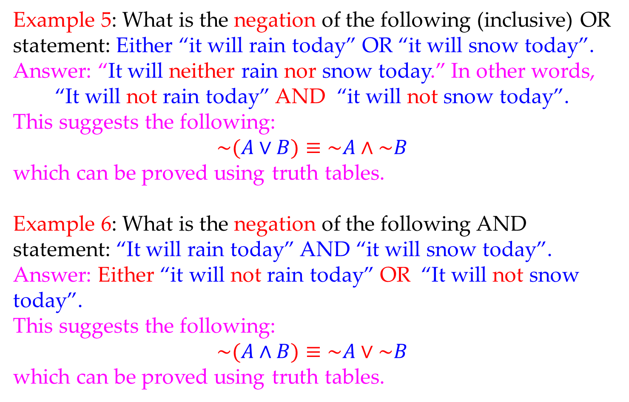
Math 263: Discrete Mathematics
2.1: De Morgan’s Laws
Example 5: What is the negation of the following (inclusive) OR statement: Either “it will rain today” OR “it will snow today”.
Answer: “It will neither rain nor snow today.” In other words,
“It will not rain today” AND “it will not snow today”.
This suggests the following:
$$\sim (A∨B)≡\sim A∧\sim B$$
which can be proved using truth tables.
Example 6: What is the negation of the following AND statement: “It will rain today” AND “it will snow today”.
Answer: Either “it will not rain today” OR “It will not snow today”.
This suggests the following:
$$\sim (A∧B)≡\sim A∨\sim B$$
which can be proved using truth tables.

Slide 20
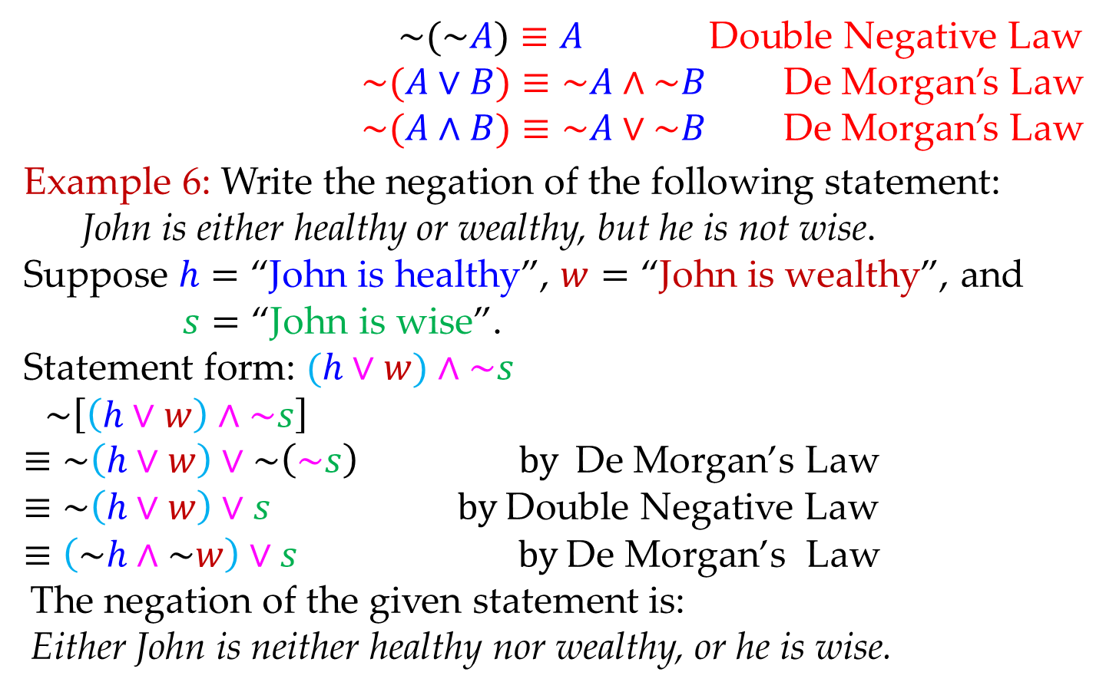
Math 263: Discrete Mathematics
2.1: Double Negative, De Morgan’s Laws
$\sim (\sim A)≡A$ Double Negative Law
$\sim (A∨B)≡\sim A∧\sim B$ De Morgan’s Law
$\sim (A∧B)≡\sim A∨\sim B$ De Morgan’s Law
Example 6: Write the negation of the following statement:
John is either healthy or wealthy, but he is not wise.
$$\text{Suppose} h=\text{“}\text{John} \text{is} \text{healthy}\text{”, }w=\text{“}\text{John} \text{is} \text{wealthy}\text{”, }\text{and}$$
$$s=\text{“}\text{John} \text{is} \text{wise}\text{”.}$$
$$\text{Statement} \text{form}\text{: }(h∨w)∧\sim s$$
$$\sim \left[\left(h∨w\right)∧\sim s\right]$$
$$≡\sim \left(h∨w\right)∨\sim \left(\sim s\right) by \text{De} \text{Morgan}\text{’}\text{s} \text{Law}$$
$$≡\sim \left(h∨w\right)∨s by \text{Double} \text{Negative} \text{Law}$$
$$≡\left(\sim h∧\sim w\right)∨s by \text{De} \text{Morgan}\text{’}\text{s} \text{Law}$$
The negation of the given statement is:
Either John is neither healthy nor wealthy, or he is wise.

Slide 21
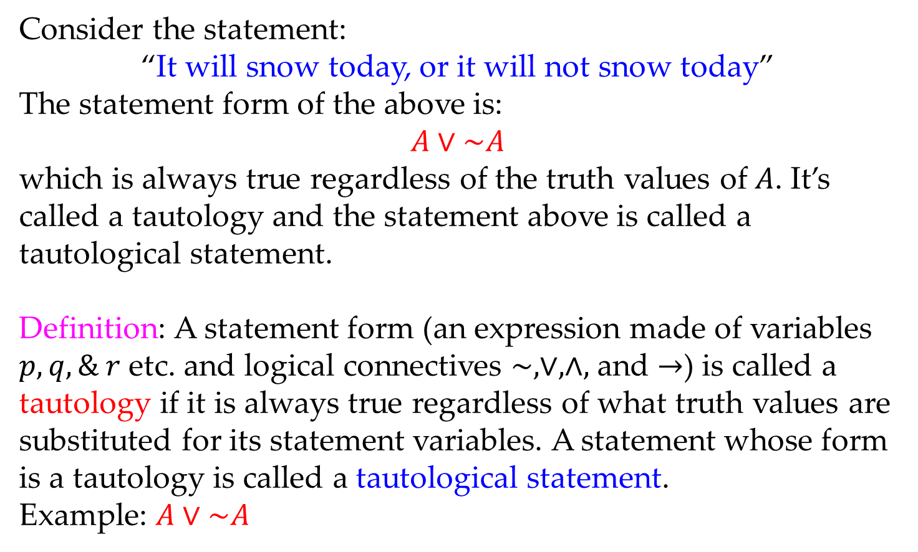
Math 263: Discrete Mathematics
2.1: Tautology and Contradiction
Consider the statement:
“It will snow today, or it will not snow today”
The statement form of the above is:
$$A∨\sim A$$
which is always true regardless of the truth values of $A$. It’s called a tautology and the statement above is called a tautological statement.
Definition: A statement form (an expression made of variables $p, q, \& r$ etc. and logical connectives $\sim , ∨, ∧,$ and $→$) is called a tautology if it is always true regardless of what truth values are substituted for its statement variables. A statement whose form is a tautology is called a tautological statement.
Example: $A∨\sim A$

Slide 22
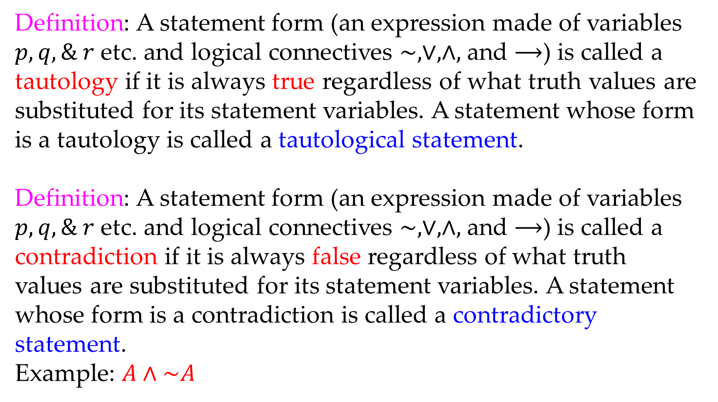
Math 263: Discrete Mathematics
2.1: Tautology and Contradiction
Definition: A statement form (an expression made of variables $p, q, \& r$ etc. and logical connectives $\sim , ∨, ∧,$ and $⟶$) is called a tautology if it is always true regardless of what truth values are substituted for its statement variables. A statement whose form is a tautology is called a tautological statement.
Definition: A statement form (an expression made of variables $p, q, \& r$ etc. and logical connectives $\sim , ∨, ∧,$ and $⟶$) is called a contradiction if it is always false regardless of what truth values are substituted for its statement variables. A statement whose form is a contradiction is called a contradictory statement.
Example: $A∧\sim A$

Slide 23
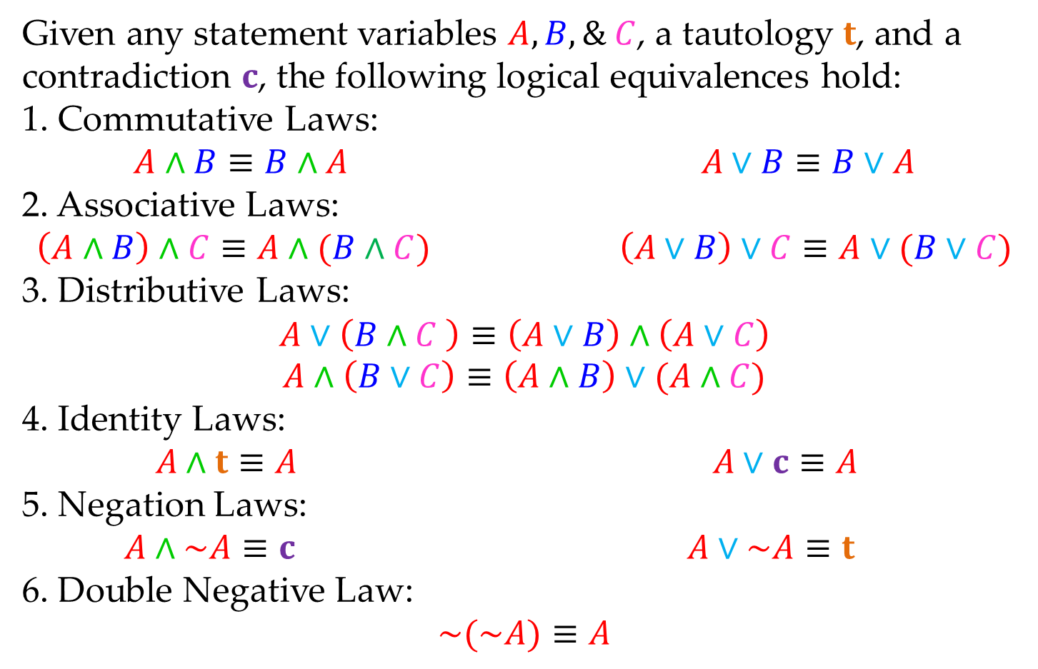
Math 263: Discrete Mathematics
2.1: Standard Logical Equivalences
Given any statement variables $A, B, \& C$, a tautology $t$, and a contradiction $c$, the following logical equivalences hold:
1. Commutative Laws:
$$A∧B≡B∧A A∨B≡B∨A$$
2. Associative Laws:
$$\left(A∧B\right)∧C≡A∧(B∧C) \left(A∨B\right)∨C≡A∨(B∨C)$$
3. Distributive Laws:
$$A∨\left(B∧C \right)≡\left(A∨B\right)∧\left(A∨C\right)$$
$$A∧\left(B∨C\right)≡\left(A∧B\right)∨(A∧C)$$
4. Identity Laws:
$$A∧t≡A A∨c≡A$$
5. Negation Laws:
$$A∧\sim A≡c A∨\sim A≡t$$
6. Double Negative Law:
$$\sim (\sim A)≡A$$

Slide 24
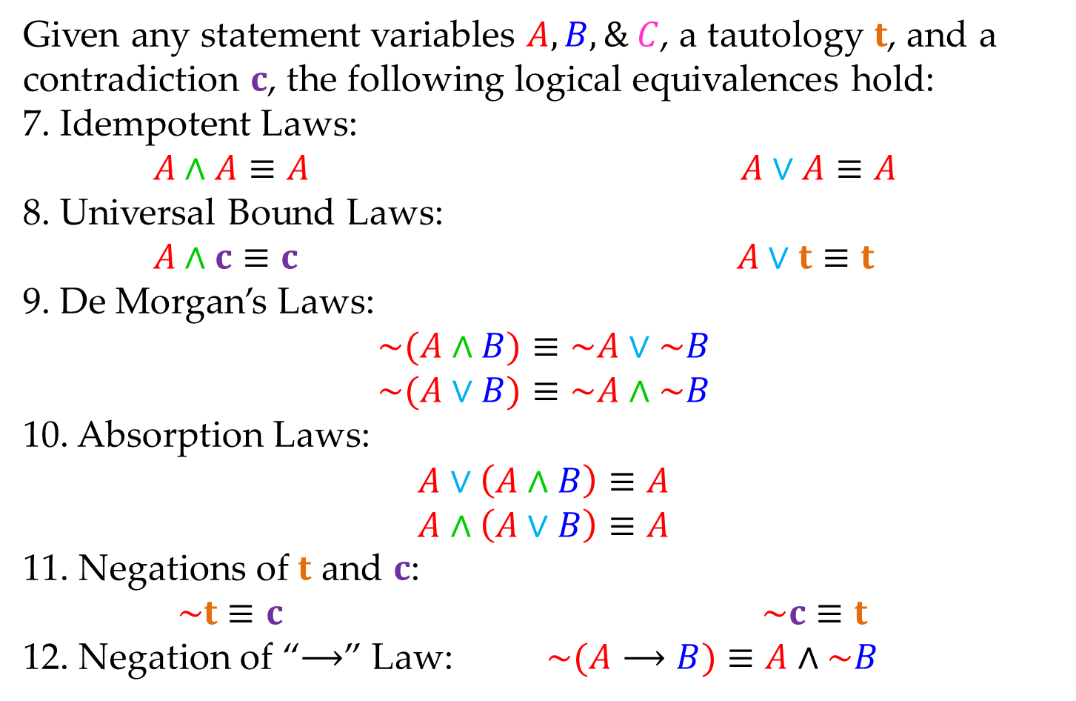
Math 263: Discrete Mathematics
2.1: Standard Logical Equivalences
Given any statement variables $A, B, \& C$, a tautology $t$, and a contradiction $c$, the following logical equivalences hold:
7. Idempotent Laws:
$$A∧A≡A A∨A≡A$$
8. Universal Bound Laws:
$$A∧c≡c A∨t≡t$$
9. De Morgan’s Laws:
$$\sim (A∧B)≡\sim A∨\sim B$$
$$\sim (A∨B)≡\sim A∧\sim B$$
10. Absorption Laws:
$$A∨\left(A∧B\right)≡A$$
$$A∧\left(A∨B\right)≡A$$
11. Negations of $t$ and $c$:
$$\sim t≡c \sim c≡t$$
12. Negation of “$⟶$” Law: $\sim (A⟶B)≡A∧\sim B$

Slide 25
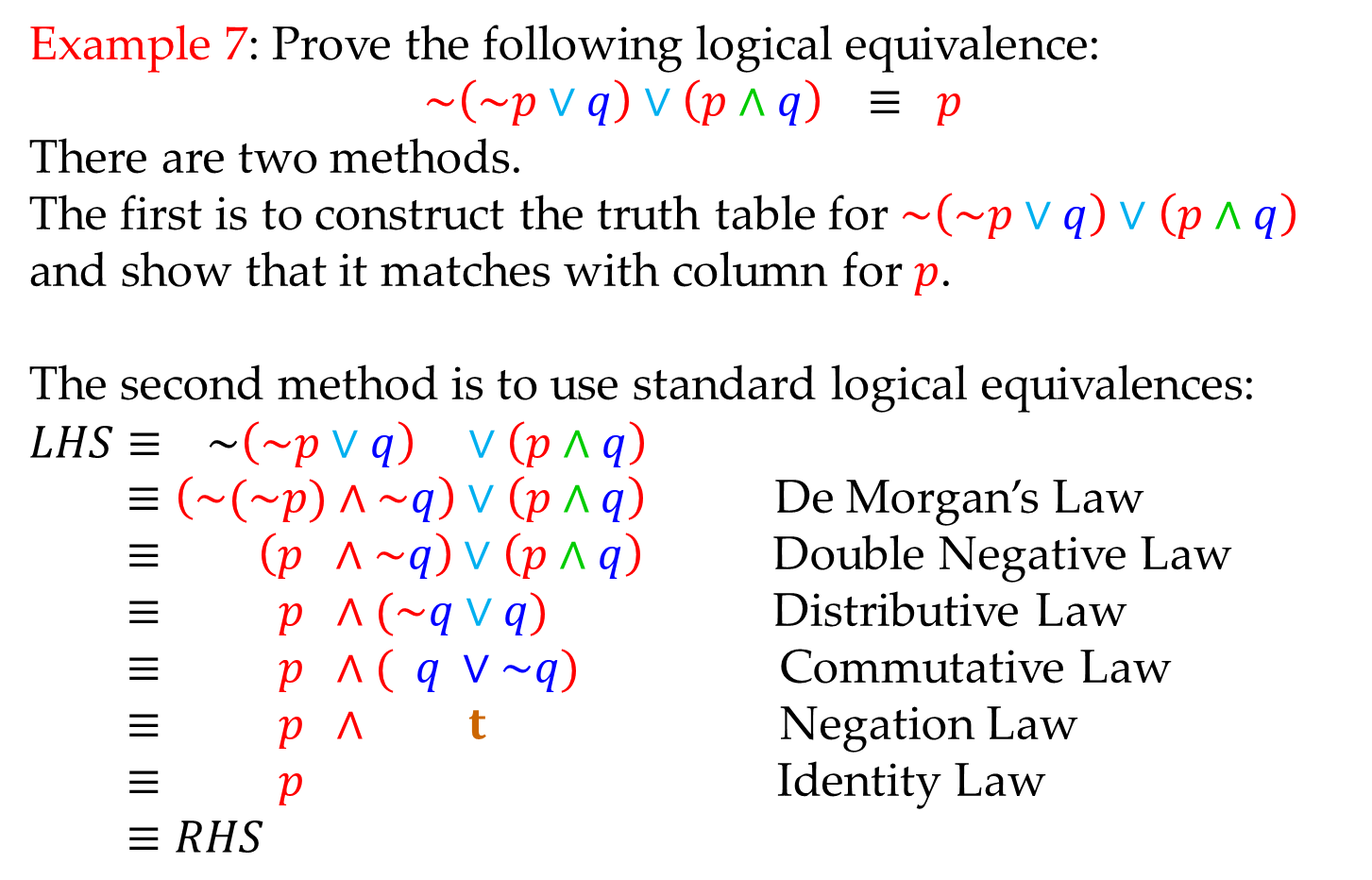
Math 263: Discrete Mathematics
2.1: Standard Logical Equivalences
Example 7: Prove the following logical equivalence:
$$\sim \left(\sim p∨q\right)∨\left(p∧q\right) ≡ p$$
There are two methods.
The first is to construct the truth table for $\sim \left(\sim p∨q\right)∨\left(p∧q\right)$ and show that it matches with column for $p$.
The second method is to use standard logical equivalences:
$$LHS≡ \sim \left(\sim p∨q\right) ∨\left(p∧q\right)$$
$≡\left(\sim (\sim p)∧\sim q\right)∨\left(p∧q\right)$ De Morgan’s Law
$≡ \left(p ∧\sim q\right)∨\left(p∧q\right)$ Double Negative Law
$≡ p ∧(\sim q∨q)$ Distributive Law
$≡ p ∧( q ∨\sim q)$ Commutative Law
$≡ p ∧ t$ Negation Law
$≡ p$ Identity Law
$$≡RHS$$

